Slide 1
Active Directory Domain Services
Windows Administration and Hardening Day 3

Slide 2

Class Objectives
By the end of today’s class, you will be able to:
Set up an Active Directory server as a domain controller and join a Windows host to it.
Create domain organizational units, users, and groups.
Set up Group Policy Objects.

Slide 3
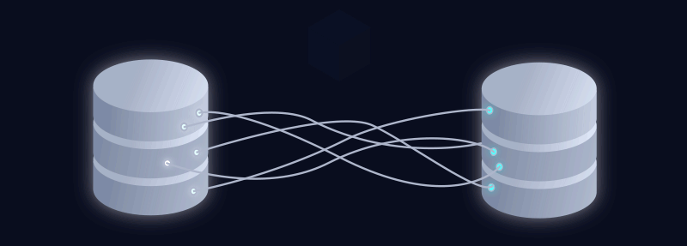
Today, we’re going to learn manage the central databasing system for enterprise-scale
Windows environments: Active Directory Domain Services (AD)
Notes:
Image source: Sergey Sprenne

Slide 4

Active Directory
Active Directory is the central databasing and management system for enterprise-scale Windows environments.
Having a strong understanding of Active Directory is crucial for anyone working in Windows-based system administration and security.
Notes:
Image source: shutterstock_1278851809

Slide 5
Active Directory
Security analysts, threat hunters, forensics experts, and incidence responders will all likely be required to know some Active Directory to be effective within their own organization or a client's.
Experts in penetration testing, threat intelligence, and malware reverse engineering will need to understand and leverage vulnerabilities to execute exploits in poorly implemented AD configurations.
Notes:
Image source: shutterstock_1278851809

Slide 6
Accessing the Lab
Before we can get started with Active Directory, we'll want to understand how it is set up and configured within our Windows Azure Lab environment.
If you have not already, take this time to log into your Windows RDP Host machine.
Then, start up and log into the nested virtual machines.

Slide 7
The Machines
Within our Windows RDP Host machine we have two nested Hyper-V virtual machines:
A Windows 10 virtual machine that has Windows 10 installed on it, just like our Windows RDP Host machine.
A Windows Server virtual machine that has the Windows Server 2019 operating system installed.

Slide 8
The Connectivity
Your Windows Azure Labs have been already set up with Active Directory Domain Services installed and configured
The Windows Server machine has Active Directory set up on it with the domain, GoodCorp.net. This will be the domain that we will be managing.
We'll be using Active Directory to set up what are known as group policies on the Windows 10 machine.
The Windows Server machine is providing DNS for the Windows 10 machine.

Slide 9
What is Active Directory?

Slide 10










What is AD?
Suppose a small startup with 20 employees receives a large amount of funding and adds 100 more employees to the company.
When the startup was small and scrappy, everyone helped each other out and had access to the same resources.
But for organizational and security reasons, the company now has to be stricter about resource access—ensuring everyone can access what they need, and not things they don’t need.
Accountants
IT Team
Everyone
Guests
need access to
needs access to
needs access to
should not have access to
Sensitive financial data
Networking components like switches and routers
Printers
Network
Notes:
Image sources: shutterstock_149136494 (computer, switch, router, printer); shutterstock_400856290 (shield/lock)shutterstock_396885847 (network access icon)

Slide 11
What is AD?
Resources are the files, networking components, and printers that users need permission to access. Permissions depend on roles and responsibilities within the company.
Security principals are the permissions and policies assigned to each set of users. They help us create specific controls for users, giving them only the access they need.
Security Principals
Accountants
IT Team
Everyone
Guests
need access to
needs access to
needs access to
should not have access to
Resources
Networking components like switches and routers
Sensitive financial data
Printers
Network
Notes:
Image sources: shutterstock_149136494 (computer, switch, router, printer); shutterstock_400856290 (shield/lock)shutterstock_396885847 (network access icon)

Slide 12
What is AD?
Microsoft’s Active Directory is the system we use to manage these resources and security principals.
Security Principals
Accountants
IT Team
Everyone
Guests
need access to
needs access to
needs access to
should not have access to
Managed via Active Directory
Resources
Networking components like switches and routers
Sensitive financial data
Printers
Network
Notes:
Image sources: shutterstock_149136494 (computer, switch, router, printer); shutterstock_400856290 (shield/lock)shutterstock_396885847 (network access icon)

Slide 13
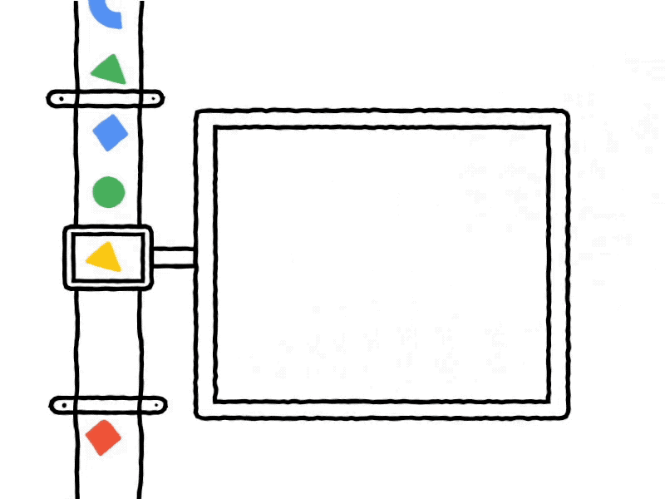
What Exactly is AD?
Active Directory is all the services that work together to manage authentication and authorization within a Windows Server network.
Authentication allows users to prove their identity using a password, token, or biometric key.
Authorization provides or denies users permission to material.
Remember the principle of least privilege from the Linux SysAdmin units?
Notes:
Image source: Beyond

Slide 14
What Exactly is AD?
Active Directory understands an organization’s resources and security principals as objects.
Objects are the users, groups, and computers, and the file shares, network printers, and other resources that users need to access.
Accounting
IT
Marketing
Guests
Objects
Networking components like switches and routers
Sensitive financial data
Printers
Network
Notes:
Image sources: shutterstock_149136494 (computer, switch, router, printer); shutterstock_400856290 (shield/lock)shutterstock_396885847 (network access icon)

Slide 15
AD Architecture
Active Directory has a hierarchical structure of organizational units, users, machines, groups, domains, trees, and forests.
Structure of Active Directory:
Active Directory
FOREST
TREE
TREE
Domains
Domains
Domains
Domains
Domains
Domains
Organizational Units
OUs
OUs
OUs
OUs
OUs
Groups
Computers
Users
Computers
Users
Computers
Users
Computers
Users
Computers
Users
Computers
Users

Slide 16
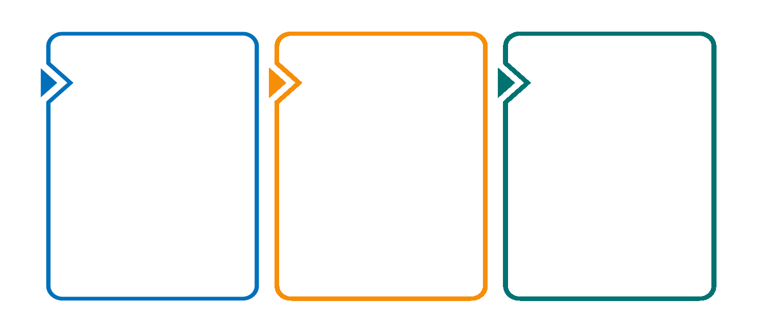
AD Authentication
AD uses the following authentication protocols:
LDAP (Lightweight Directory Access Protocol)
A standardized protocol for adding, deleting, and editing objects. If Active Directory is a journal of information, LDAP is the pencil and eraser.
Kerberos
A ticket-based authentication protocol, now the default authentication protocol for Windows Server domains. Provides direct encrypted sessions between users and networked resources.
NTLM (New Technology LAN Manager)
A an authentication protocol that has become outdated because of pass the hash attacks.
We’ll learn more about protocols in our Networking units, and will
discuss these specific protocols during our Pentesting units.
Notes:
Image source: shutterstock_1367319962

Slide 17
Kerberos Overview
Bob is attempting to access a networked file server:
Once his credentials are verified, Bob receives a TGT that allows him to request access to resources.
That TGT is cached and permits him to request more tickets for the current domain session.
When Bob attempts to access the file server, he sends the Ticket Granting Ticket to the Ticket Granting Server, requesting access to the file server.
The Key Distribution Center checks if the file server exists and if the TGT is valid. If it is, the KDC sends Bob an encrypted service ticket containing info he authenticated earlier, and a session key. Bob is then sent the encrypted service ticket and a copy of the session key.
Bob’s Windows 10 machine sends a request to authenticate the Key Distribution Center (KDC), seeking a Ticket Granting Ticket (TGT).
A KDC has a database of valid credentials, an Authentication Server and a Ticket Granting Server.
4
1
2
3

Slide 18
Kerberos Overview
Bob is attempting to access a networked file server:
Bob then uses the session key to encrypt a new message containing his current information and send that, along with the service ticket, to the file server.
The file server then decrypts the service ticket containing the session key, and uses that session key to decrypt the message from Bob that contains his current information.
Finally, the file server uses the session key to encrypt a new message to be sent to Bob containing information about the file server.
If Bob’s existing copy of the session key properly decrypts the message, the file server is verified.
5
6
7

Slide 19
Creating OUs, Users and Groups

Slide 20

Creating OUs, Users and Groups
Now that we’ve introduced Active Directory domain controller, we’ll assign organizational units and groups.
Organizational units (OUs) are logical groupings of an organization’s assets and accounts.
For example, all of the computers in the sales department of our company should be grouped together in an organizational unit, which might be called GC Users > Sales.
All of these computers would have the same policies, set by the group policies.
Notes:
Image source: shutterstock_1993681

Slide 21
Creating OUs, Users and Groups
In the following demo, we will:
Create a new domain organizational unit called GC Users.
Create a sub-OU called Marketing.
Create a user, Caroline, under the GC Users > Marketing OU.
Create a group, Marketing, under the GC Users > Marketing OU.

Slide 22
Creating Organizational Units

Slide 23
Activity: Creating Domain OUs, Users, and Groups
For this activity, you will set up users, groups, and organizational units for your recently created domain.
20 Minutes

